Slide 1


Slide 2

Minor Project
Fake News Detection using ML
Tags
Issues
Literature Survey
Conclusion
Model
Introduction
PRESENTATION BY Saumya Srivastava(2018IMG-056)

Slide 3
INTRODUCTION
Recent political events have expanded the popularity and spread of fake news. As demonstrated by the widespread ramifications of the big onset of fake news, humans are inconsistent, if not outright poor detectors of fake news. With this in mind, efforts have been made to automate the process of fake news detection. Widely known of such attempts include “blacklists” of sources and authors which can be unreliable. While these tools are useful, so that you can create a far more comprehensive solution, we need to account for more perplexing cases where reliable sources and authors release fake news. As a result, the goal of this project was to create a tool for detecting the language patterns that characterize fake and real news through the usage of ML and NLP techniques.
Conclusion
Results
Tags
Literature Survey
Introduction
System Model

Slide 4



LITERATURE SURVEY OF EXISTING MODELS
1
2
3
Literature
Survey
Conclusion
HANSELOWSKI
(2018)
KIM
(2014)
WANG
(2017)
Tags
Results
Model
Introduction

Slide 5
My baseline model uses bi-LSTM. The input comprises of 2 embeddings. First one for news statement and next one for meta-data.
Meta-data consists of info about speaker of the statement, the party to which the speaker belongs, job-title, the venue where the statement was made and the subject of the statement. These two embeddings are fed as input to a Deep Learning model to produce softmax probabilities over the 6 output classes. The choice of Deep Learning model varies viz. CNN, LSTM, bi-LSTM, LSTM+CNN (hybrid) and many more.
For the baseline, I have experimented with bi-LSTM.
Statement Embeddings: I used GloVe pre-trained vector representations for words. I generated the embedding matrix of (vocabulary size x 100) dimensions wherein every word present in vocabulary is represented as a 100-dimensional vector. I used this embedding matrix as weights to generate the Embeddings for each input statement.
Meta-data: For each of the Meta-data (viz. speaker, job, subject, party, state, venue) of the statement, I took top-k frequently appearing categories and club remaining infrequent categories under "others" label. Hence, I obtained a k-dimensional one-hot vector encoding for each of the meta-data. The value of k is different for different meta-data and is selected after carefully evaluating the dataset and distribution of meta-data information.
Tags
Literature
Survey
Conclusion
Results
Model
Introduction
So, I input the statement embedding to a bi-LSTM and the binary metadata features (83-dimensional) to a Dense layer. Finally, I concatenated these two layers to obtained richer representations and pass them to a Dense Layer which performs the classification by generating softmax probabilities over the 6 output classes.

Slide 6
THE ISSUES
I attempted trying out different pair of input features (viz, only statement whilst the input, statement and anyone associated with the metadata as the input) and also have analysed the total results.
However, utilising the statement embedding while using the metadata features, I got an accuracy of 27.78%.
My baseline comprising usage of (statement + metadata) surpassed the best model with 27.4% (mentioned in Wang, 2017).
However, generally in most for the news that is fake, I observed there are syntactical features which are not incorporated in the said model.
Hence, to address this shortcoming, I incorporated POS tags and dependency parse of the statement in my feature set which helps to learn richer representations of the data, thus, increasing the accuracy of predictions.
Conclusion
Literature
Survey
Tags
Issues
Model
Introduction

Slide 7


POS TAGS
For each statement (without removing the stop words), I generated the POS tags for every single word. I chose the top nine frequently occurring POS tags (NOUN, VERB, ADP, PROPN, PUNCT, DET, ADJ, NUM, ADV) from the training set as individual labels and clubbed the residual tags under a common label X. Further, I represented each POS tag as a 10-dimensional one hot vector. I created a POS matrix that is embedding of 10 x 10 dimensions which is practically an identity matrix wherein row-i corresponds to the embedding for Ith POS tag.
DEPENDENCY PARSE TAGS
Literature
Survey
Conclusion
Tags
Issues
Model
Introduction
For every single declaration (without removing stop words), we considered dependency parse that are frequently appearing (punct, prep, pobj, compound, det, nsubj, ROOT, amod, dobj, aux) within the training set as individual labels as well as other infrequent relations under one label that is typical. Ergo, each Dependency Parse connection is now represented as 11-dimensional vector that is one-hot. We created DEP matrix that is an embedding of 11 x 11 measurements which fundamentally can be an identity matrix wherein row i corresponds to your embedding for the DEP label that is ith.

Slide 8
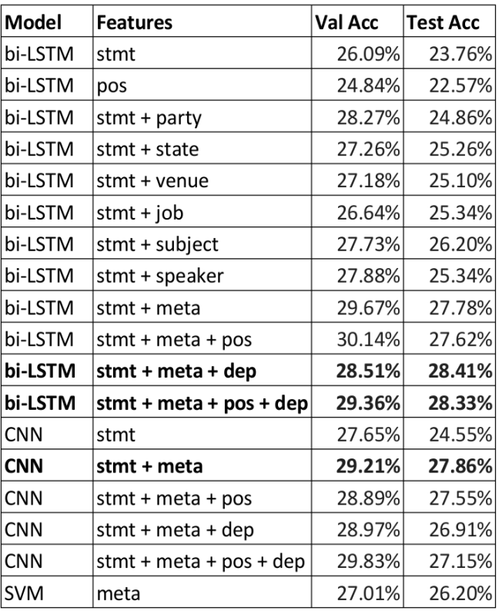
CONCLUSION FROM RESULTS OF DIFFERENT MODELS
I observed that Bi-LSTM with statement, metadata and dependency parse provides the best accuracy closely followed by the model using Bi-LSTM with statement, metadata, dependency parse and POS tags.
I observed that just utilizing POS tags along with statements does not give good accuracies. Also, SVM does not produce comparable results to LSTMs.
Conclusion
Literature
Survey
Tags
Issues
Model
Introduction

Slide 9
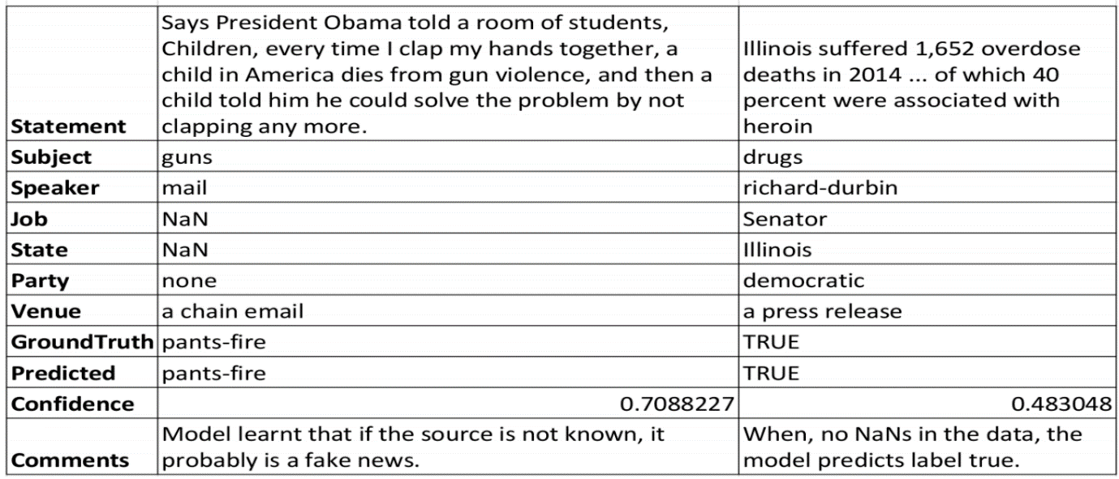
SAMPLE PREDICTIONS BY MY MODEL

Slide 10
Thank You!!

